Slide 1
Alaska CSSD NSTAR Re-platforming Project
Alaska Division of Child Support Services
February 5, 2019

Slide 2
Presentation Overview
Child Support in Alaska
Current System (NSTAR)
Re-platform Decision
Re-platform Project
Next Steps

Slide 3
Overview of Alaska CSSD
Vision:
We strive to ensure children receive their support through cooperation and collaboration using innovation to drive our success with the communities, partners, and families we serve.
Mission:
Collect and Disburse Child Support
Values:
Individuality
Honesty
Respect
Accountability
Fairness
Transparency

Slide 4
Overview of Alaska CSSD
Administrative
45,000 Cases
150 Batch Jobs
Permanent Fund Dividend

Slide 5
Current System (NSTAR)
Old
Mainframe
Natural and COBOL languages
ADABAS Database
High Maintenance
Inflexible
Manual Processes
Operating Costs
Staff Skill Sets
Fast Performance
Huge Database

Slide 6
NSTAR Replacement Project
New System (2013)
Feasibility Study Completed…
State Economy
Political Considerations
Timeline
Cost

Slide 7
NSTAR Re-platform Project
Goals:
Off of Mainframe
Flexible Structure
Staff Hiring
Efficiencies Gained
Future Expansion/Enhancements
Federal Funding:
Use Remaining Funding to Clean-up/Fix problems
Like-for-Like – no need for APD
Total Capital $5M – 66% fed 34% state

Slide 8
NSTAR Re-platform Project
RFP Process & Award
Requirements
Cost - fixed
Timeline – 18 months
Iteration Approach
Risks Upfront
Streamlined Bid
First Time for Vendor
Limited Resources

Slide 9
Iteration Approach
1 -
Database
Mainframe
System
Case Intake & Establishment
2 -
3 -
Locate I, Enforcement 1 & Financials
4 -
Enforcement II & Financials II
5 -
Enforcement III & Financials III
6 -
Locate II, Fed. Reports & Intergov.
7 -
Reporting I & Customer Service
8 -
Reporting II
Notes:
The NSTAR Re-platforming Project is divided in to multiple iterations with each addressing one or more corresponding functional areas. Each functional area is broken down further into online system components and batch programs. Deliverables, development, UAT and project schedule and payment are all based on these iterations.

Slide 10
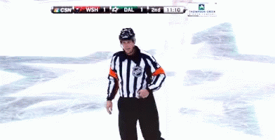
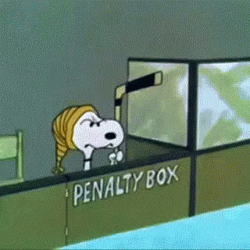
Re-platforming Project
Problems
6 Month Delay
IT Management Change
System Performance
Data Issues
Batch Performance
Turnover in Testing (Manual)
Forms Change Order
Lack of Resources
20% staff cut

Slide 11
Re-platforming Project
Current Successes
Quality Product
System Cleanup
Old Programs
Old Interface & Better Interfaces

Slide 12
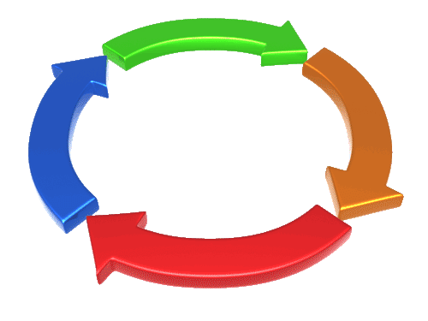
Re-platforming Project
Current Status
Change on Testing Approach
Iteration Approach
SIT vs UAT
Online
Batch
Forms
Completion – April 15, 2019
Additional Resources
60% Complete
Cost To Date
Timeline Extension

Slide 13
Re-platforming Project
Could’ve, Would’ve, Should’ve….
View from halfway…
Explore Better Way Off Mainframe
Adabas on Microsoft
Migrate Off Mainframe vs New System
Requirements Approach
Required vs Self Imposed
Business Process Review
Quality Control Manager
Project Approach
Waterfall vs Agile
Custom vs COTS

Slide 14
Alaska Child Support Next Steps
COTS Options
Cost
New System – “empty suit”
Business Process Change Acceptance
Quick Implementation Timeline
Reduction in Additional Costs
Federal Certification

Slide 15
Alaska Child Support Next Steps
Modernize Systems & Services
Client Focus -
Secure Access to Documents
Electronic vs Paper
Self Help
Internet
Mobile App
Staff Focus -
Single Screen Access
Simplified Processes
Eliminate “stupid processes”

Slide 16
Alaska Child Support Next Steps
Anticipate:
Cost Savings
Eliminate Mainframe Costs
Cost of Scheduler
Print Solution
Efficiencies (Staff & Procedures)
Business Process Review

Slide 17
Child Support Next Steps
Goals
Fully Electronic
Ease of Use and Access
Amazon of Child Support

Slide 18
Questions?

