Slide 1
National Council of
Child Support Directors Conference
Building Integrated Services Models to Effectively Address Customers’ Needs and Strengthen Family Capacity
Karen Hebert, IV-D Director, New Hampshire
Larry Desbien, IV-D Director, Colorado
Erin Frisch, Chief Deputy Director
for Opportunity, Michigan

Slide 2

Changing NH Service Delivery
State of New Hampshire
Department of Health and Human Services
Division of Economic and Housing Stability
Bureau of Child Support Services
Constructing a future where all families will
Live Free and Thrive
Karen Hebert, IV-D Director
State of New Hampshire
Department of Health and Human Services
603-223-4822 (o); 603-573-6311 (c)
Karen.hebert@dhhs.nh.gov

Slide 3
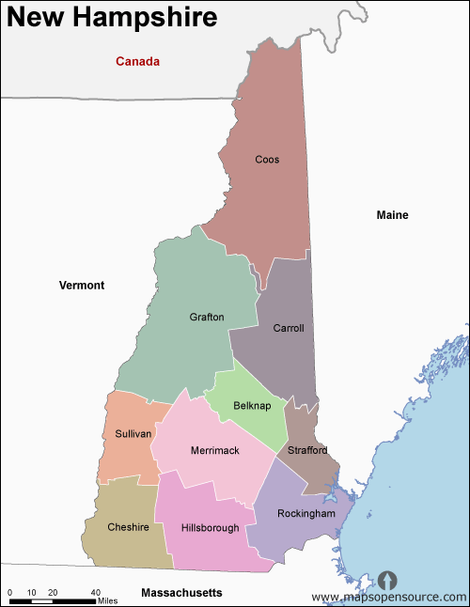
New Hampshire Snapshot
Population – 1.37 Million www.census.gov; www.kidscount.org
  90% White 3.9% Hispanic
  3% Asian 1.7% Black 0.3% Native American
  7.8% non-English speaking
  7.7% in Poverty 7.5% without health insurance
  19% under 18
  92.8% educated high school and higher
  2% unemployment rate
Median Gross Rent $1347
Minimum wage $7.25
Tourism #1 industry
No sales or income tax

Slide 4
Challenges in NH
Limited workforce to meet current and increasing needs
Aging workforce, lack of transportation, seasonal employment, Gig economy
Barriers to family well-being and employment stability:
    Increased need for barrier reduction/resolution
    Benefits Cliff Effect
    Opioid Crisis
    Inconsistent employment availability
    Lack of affordable/available housing
Lack of coordinated data across the Division
Perceptions versus realities of data/information
Federal/State mandates continue to support siloed programs
Knowing HOW to "team"-work in a matrixed and integrated way where there is shared responsibility and accountability
Notes:
the benefits cliff - wages do not compensate for loss of benefits

Slide 5

Organizing for Strength and Innovation
Setting our North Stars
  Culture of safety
  Integration and Innovation
  Emphasis on integrity
  Alignment of outcomes
Refreshing our agency and program governance
  Simplifying structures
  Moving upstream
  Orienting towards teaming
  Alignment of program and policy
Building relationships, partnerships, and collective responsibility
  Change in leadership, new staff from outside state government
  New conversations; listening to stakeholders
  Partnering with Non-profits differently
  Promoting regional learning communities
Notes:
Initiated a Safety Culture – staff and children, youth and communities. A safety culture is one in which organizational values, attitudes, and behaviors support a safe, engaged workforce, and reliable service delivery. Leaders within a safety culture:
Balance systems and individual accountability
Value open communication, transparency, and continuous learning and improvement
“Organizational Refresh” – breaking down silos and merging staff into teams – adding capacity in key areas– efficiency
Program and policy alignment to improve employment opportunity and economic stability for low-income parents.
Systems innovations and collaborations that improve success in education, training and employment for parents.
Where can we put Two Generational practices attending to the needs of both adult and child for family well-being.
Regional learning community focused on whole family approaches to employment equity and family success.

Slide 6

Guiding principles driving our efforts
Upstream prevention must be a priority
Whole family, person-centered lens across all that we do
Easier, quicker access – “every door is the right door”
Locally designed and coordinated continuums of care
Sharing your story once
Equity every time
Data driven services, solutions and systems
Redefined “boundaries” – partnerships with role clarity and shared accountability
Blending and braiding funding whenever and wherever possible

Slide 7
INGREDIENTS FOR SUCCESSFUL STRATEGIES
Parent informed and family centered
Ongoing engagement and coaching over time with families
Social capital/peer support embedded locally
Integrated partnerships with range of services
Requires best fit staff, intensive and high quality services
Strong infrastructure to support the work
Learning culture with rapid cycle testing of innovations
Informed by and contributing to racial equity
Use of data within organization and across partners
Skilled use of blended funding streams
Bridge to policy and systems change

Slide 8
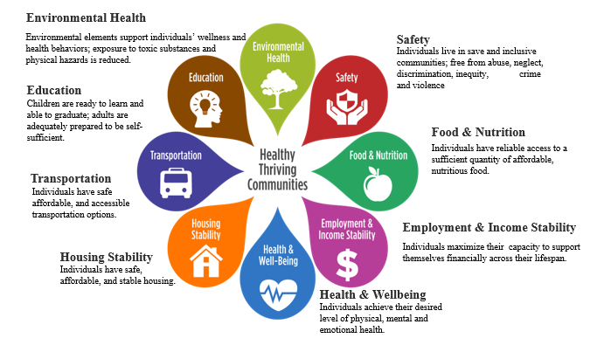
Social Determinants of Health Framework
Notes:
A way to look across programs through the lens of the Social Determinates of Health
The social determinants of health are the conditions in which people are born, grow, live, work and age. These circumstances are shaped by the distribution of money, power and resources at global, national and local levels. The social determinants of health are mostly responsible for health inequities - the unfair and avoidable differences in health status seen within and between countries. We believe that health and wellness are impacted by social and environmental factors that must be considered in our work.
Utilizing these concepts the Office of Human Services is identifying, through an inventory of services, potential linkages that can be developed or enhanced between each of its programs; ultimately across the Department. You can easily find indirect connections for almost of the areas, so narrowing them down to the core elements is challenging.

Slide 9

NH Department of Health and Human Services
DHHS Overview*
Office of the Commissioner
Administrative Business Supports
• Legal & Regulatory • Health Equity
• Program Planning & Integrity • Finance
• Quality Assurance & Improvement
Population Health
Human Services & Behavioral Health
Operations
Division of Economic & Housing Stability
Family Assistance
Employment Supports
Housing Supports
Child Support Services
Child Development & Headstart Collaboration
Bureau of Information Services
Data Management
Data Warehouse
  Information Security
Medicaid Management Information System
DHHS Systems Oversight
Linkage to DoIT
Division of Public Health
Population Health & Community Services
Infectious Disease Control
Public Health Protection
Laboratory Services
Public Health Statistics and Information
Public Health Systems, Policy & Performance
State Epidemiologist
Division of Behavioral Health
Mental Health
Drug & Alcohol Services
Children’s Mental Health
Bureau of Human Resource Management
Organizational Development &
Training Services
Division of Medicaid Services
Clinical Operations
Medicaid Policy
Dental Services
Health Care Reform
Managed Care
Division of Long Term Supports & Svcs
Adult Protection Services
Elderly & Adult Services
Developmental Services
Designated Receiving Facility
Special Medical Services
Community Based Military Programs
Bureau of Facilities Maintenance &
Office Services
HHS Facilities & State Office
Safety & Wellness
Office Services
Oversight – Institutional Services
DHHS 24/7 Facilities
New Hampshire Hospital
Glencliff Home for the Elderly
Sununu Youth Services Center
Designated Receiving Facility
Division of Children, Youth & Families
Field Services
Family, Community & Program Support
Organizational Learning & Quality Improvement
Sununu Youth Services Center
Communications Bureau
Emergency Services Unit
Employee Assistance Program
* Overview represents DHHS program areas, functions and business entities, not necessarily reporting structures.7/18

Slide 10
Division of Economic & Housing Stability
Associate Commissioner
Human Services & Behavioral Health
Family Strengthening &
Child Well-Being Initiative
Division for Behavioral Health
Division of Long Term Supports & Services
Division of Children, Youth & Families
*From left to right - Emphasis on rapid and holistic engagement with integrated, targeted supports and services to prevent deeper involvement and interventions whenever possible and appropriate
Family Assistance
Employment Supports
Child Support
Child Development & Head Start Collaboration
Housing Supports
Mental Health
Drug & Alcohol
Children’s Mental Health
Elderly & Adult
Developmental Services
Special Medical
Community Military Programs
Field Services
Family, Community & Program Support
Learning & Quality Improvement
Notes:
Looking left to right – as we do in the western world – we’re looking to creating a “First touch is the right touch” experience for our citizens in need – with an emphasis on PREVENTING deeper system involvement.
Created in April 2018 to promote a more holistic, multi-generational and integrated approach for individuals, children, and families that may be in need of an array of supports and services, such as child care, housing, food, economic and employment assistance.
The Division includes:
The Bureau of Family Assistance;
The Bureau of Child Support Services;
The Bureau of Housing Supports;
The Bureau of Child Development & Head Start Collaboration; and
The Bureau of Employment Supports.

Slide 11
DEHS Vision and Mission
VISION
Individuals and families are strong, resilient, and thriving in their communities.
MISSION
Provide integrated opportunities to strengthen individuals families, and communities.
Notes:
We believe in a solution-focused approach based on individualized needs and preference

Slide 12
Division of Economic & Housing Stability
Innovation
Prevention
Holistic Engagement
Targeted Supports
Integration
Serves individuals and families from birth through lifespan
Emphasizes importance of Social Determinants of Health and its impact on a person/family
Provides a whole person/whole family approach
Notes:
This is what DEHS aims to do by coming together, targeting our supports and services to be integrated, supporting the whole family, making sure every door is the right door and a pathway to upstream services that may delay or prevent more intrusive downstream services.
SDOH are those factors such as socioeconomic status, education, the location of where a person lives, employment, social supports, access to health care- DEHS programs touch and influence this- some directly and some indirectly, but by integrating and coordinating, we have the opportunity to create a better, sustainable impact for those we serve.

Slide 13
Division of Economic & Housing Stability
Reduce programmatic and system barriers and silos to services
Create synergies and coordinated efforts
Provide shared leadership in the commitment to integration and cross-sector teamwork
Work horizontally and vertically with DHHS programs and community stakeholders to create integrated approach to services
Map Social Determinants of Health with all programs to determine gaps and develop best practices
Innovation
Prevention
Holistic Engagement
Targeted Supports
Integration

Slide 14
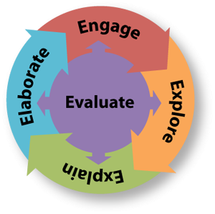
Health & Human Services Integration Teams
Child Welfare Transformation
Suicide Prevention
Early Childhood
Children affected by caregiver substance use disorders
Father Engagement
Data Analytics
Multi-system involved youth/families
Medicaid Academy
Chartered approach
Varied leadership and membership
Inter and Intra organizational efforts
Economic & Housing Stability
Behavioral Health
Long Term Supports & Services
Child Protection, Juvenile Justice
Public Health
Medicaid
DHHS System-Wide
Notes:
Leveraging all efforts: Child Support is at the table in these
Prioritizing Early Childhood and Community Based Efforts
Transforming our Child Welfare System
Creating a 10 Year Mental Health Plan
Designing a “State” Opioid Response system
Establishing a Whole Family Approach to Jobs: Parents Working, Children Thriving Initiative

Slide 15
Key Outcomes
Increased population-based prevention efforts at the community level
Increased Protective and Resiliency Factors among families
Shifting from a siloed system that is compliance-driven to one that serves the whole family/person based on needs, and with prevention programming.
Regional and population-based data analytics for data-driven decision-making.
New upstream prevention services through Family Resource Centers for families at risk.
Additional community and evidenced-based preventive services, such as Home Visiting , for families before they have contact with downstream services, i.e. child welfare system
More effective community collaboration and systems change through models including Boundary Spanning Leadership and Whole Families Approach to Jobs

Slide 16
Collaboration to Integration
Operationalizing Service Integration – Make Every Door the Right Door
The right services, at the right time, at the right place
Talent Development – Learning Systems
Child Support | Concrete support to increase capacity
Behavioral Health | Mental health support; substance use treatment
Employment Supports | Work Programs; Motivational Interviewing
Head Start Collaboration | Parenting Education and Support
Family Assistance | Financial Assistance; Healthcare
Housing | Housing needs; veterans services
Public Health | Health & wellness; home visiting
IT and Program Interfaces | Integrate services; empower employees and citizens; collect and analyze needed data
Notes:
Each collaboration meets Child Support objectives
How do we tap into other programs’ resources to meet our objectives and serve families based on their needs?
How do we identify and assess our customers’ needs to link them with the right services at the right time and wherever they are?
Talent Development – creating leaders at all levels

Slide 17
External Collaborations
Community Collaboration to Strengthen & Preserve Families – 5 year grant | Protective Factors Framework: Child Welfare Transformation; Community-based Delivery Systems
NH Judicial Branch | Parenting Plan track parallel to IV-D cases
Department of Corrections | Prison Outreach
DHHS Multi-program Father Engagement | Policy Enhancement and Alignment; Strengthening Services
NH Employment Security | Work Programs
Department of Education | Preschool Development Grant
Notes:
CCSPF: This grant was part of our larger child welfare transformation efforts and developing local community based seamless delivery systems focused on family strengthening based on the protective factors framework. NH DHHS is the only state agency awarded this 5-year grant
Judicial Branch – A&V funding
DOC
Engaging father with programs, and helping fathers engage with their children; incorporate other existing services and programs to enhance them: DOC, NHES, DCYF, DOE, Public Health

Slide 18
Getting Started
Identify a common internal language
Use the right language in descriptions and how you refer to people; rebrand while creating new frame and service integration
Identify root cause and identify targeted interventions to address those root causes; will lead to positive outcomes
Identify what data to collect
Aim for cost savings AND quality services
Housing can be a ticket to solving other challenges
Target and invest in higher risk populations
Create a strategy around prevention
Courtesy Frank Alexander, Boulder County, CO

Slide 19

Colorado’s Approach to an
Integrated Services Model
Larry Desbien
Director
P 303.866.4460
1575 Sherman Street, 5th floor
Denver CO 80203
e-mail: larry.desbien@state.co.us

Slide 20
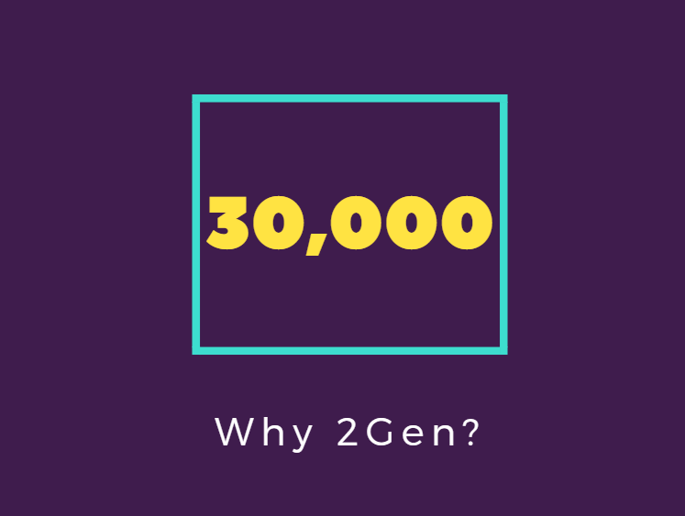
Notes:
A third of all families (30,000) receiving IV-D services receive nothing toward their current monthly child support obligation
Colorado’s statutes, policies and practices aren’t working effectively for current and former TANF families and the parents responsible for paying child support to them
What are we doing to reduce the zero payer rate? 1 - programmatic changes such as Pass Through, 2 - legislative changes to the child support guidelines for low income families, and 3 – the focus of this presentation, connecting families to the resources they need to more fully engage and pay their child support

Slide 21

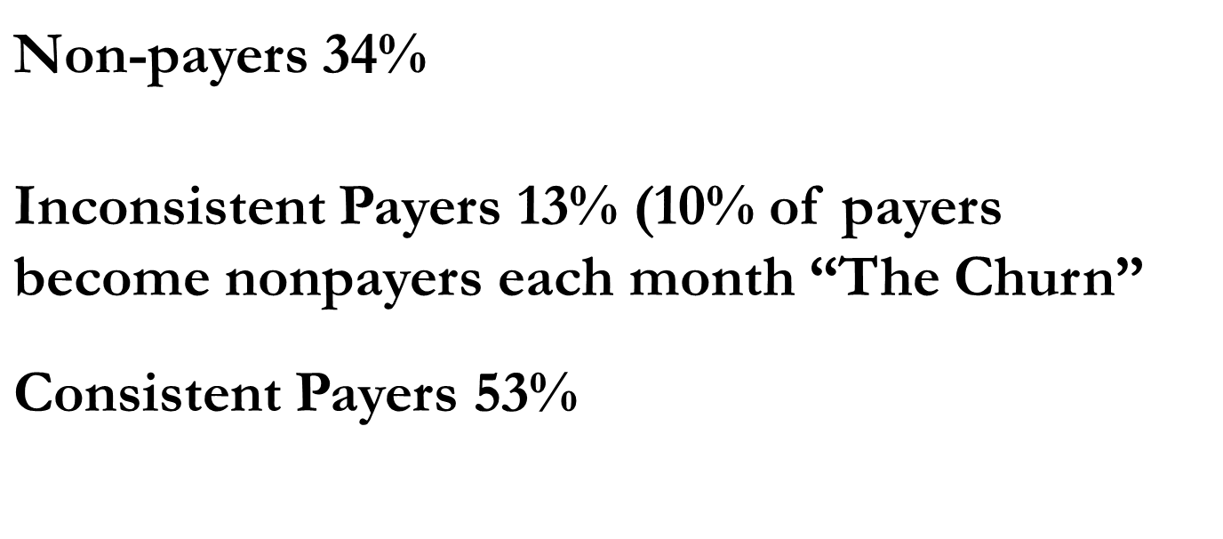
90,000 parents with a current monthly child support obligation

Slide 22
What Does the Data Show?

Slide 23
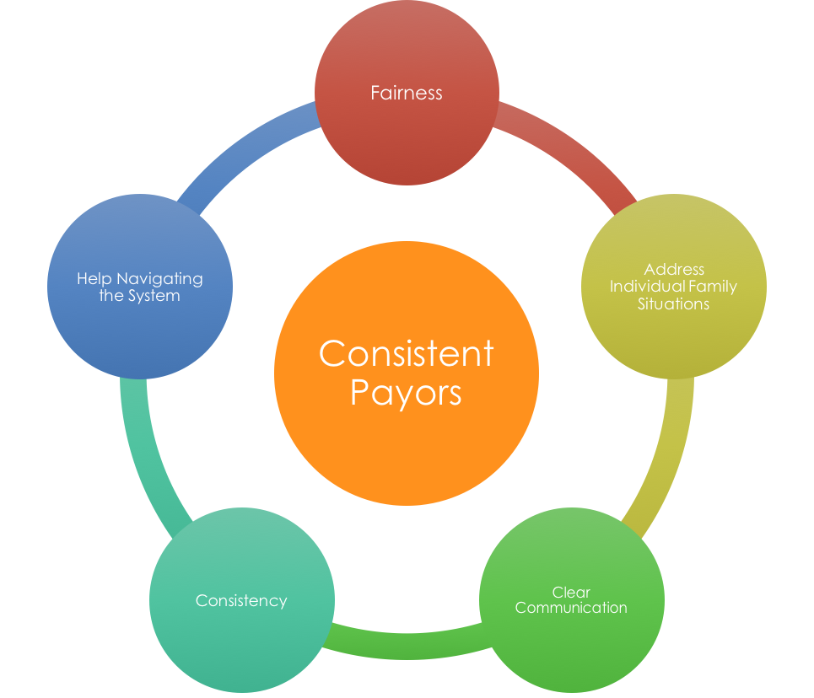
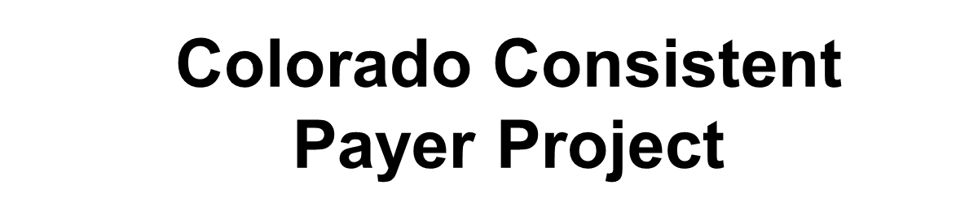
Learning from the voice of customers and stakeholders

Slide 24

Opportunity
High
Low
Low
Historical
Desire
High
?
What if we redesigned the system to create the ability for parents with a willingness to pay who aren’t currently able to?

Slide 25
Use of the Family Resource Assessment
PHASE 1: ASSESSMENT
FRA Sample size is Met
Final Report Published
Jan
2018
April 2017
Results Inform Phase II
FRA Testing Begins in Pilot Counties
Nov 2017
Data Shared for Analysis
March 2018

Slide 26
Sample Questions from the
Family Resource Assessment
Do you have a relationship with the child(ren) named in the child support case?
□ Yes □ No □ No response
Are you satisfied with your relationship with your child(ren)?
□ Yes □ Sometimes □ No □ No response
How often do you see the child(ren) named in this child support case?
□ At least once most weeks □ At least once most months □ At least a few times a year
□ Less than a few times a year □ Never □ No response
Are you able to pay your child support?
□ Yes □ Sometimes □ No □ No response

Slide 27
Sample Questions from the
Family Resource Assessment
Are you willing to pay your child support?
□ Yes □ Sometimes □ No □ No response
For some parents, getting or keeping a job affects their ability to pay child support. Have you experienced difficulty getting or keeping employment due to:
□ Job Market / Employment Availability
□ Education or training
□ Transportation
□ Your physical health
□ Your mental health
□ Substance use
□ Family or parenting disagreements
□ Family violence
□ Felony or misdemeanor conviction
□ Department of Corrections involvement
□ Child Protective Services involvement
□ Other: _______________________

Slide 28
Sample Questions from the
Family Resource Assessment
Right now, are you employed?
□Yes □ No □ No response
About how many hours a week do you work? ________
Do you think you will be in the same job three months from now?
□ Yes □ No □ Don’t know □ No response
Scoring
If a person reports working less than 40 hours weekly, they are eligible for specialized services.
If a person reports 2+ barriers to employment, they are eligible for specialized services.

Slide 29
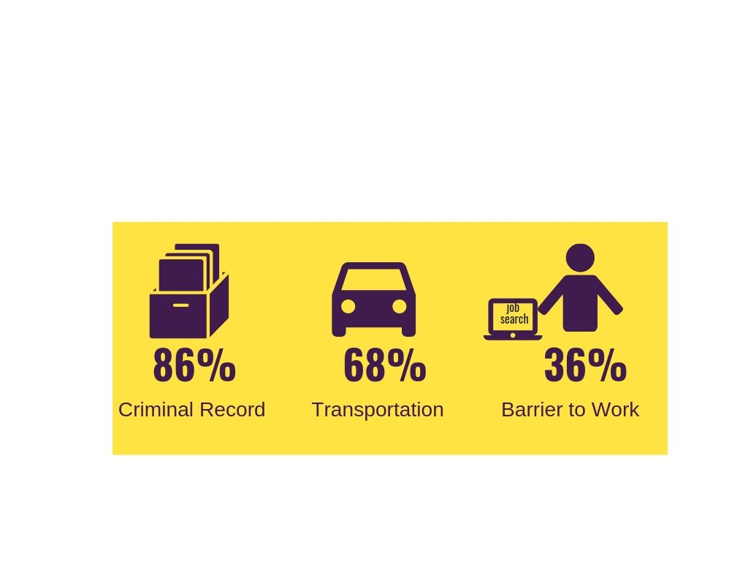
12 Questions Tell You a Lot!
PHASE 1: RESULTS
Notes:
36% - For every barrier to employment reported, the odds of paying decreased by 34-38% making it the strongest predictor of payment behavior.
86% - A parent who reported having a felony or misdemeanor conviction has a decreased likelihood of paying their child support order by 86%.
68% - Access to transportation was another barrier to employment associated with risk. It decreased likelihood to pay by 68%.
Reported mental health may make a person at risk of nonpayment. Due to sample size, this should be further studied.

Slide 30
PHASE 2: INTERVENTION
Recruitment Ends; 6mths of Service Delivery
Final Report to be Published
May 2019
April 2018
Statewide 2Gen
Roll Out
Case Management & Resource Connection
Nov 2018
Data Shared for Analysis
Oct 2019

Slide 31
PHASE 2: INTERVENTION
420 Parents Total Needed to be Recruited
  210 Served with 2Gen Model
$200 Supportive Service Funds Available Per Parent
  11 Pilot Counties Participating
  4 Additional Case Management Trainings
  1 ACSES Enhancement to Track Outcomes

Slide 32
Defining the 2Gen Model – 10 Indicators
Leadership, Commitment, Culture – Evidence of a site’s leadership-driven culture of commitment to 2Gen principles
2. Data Sharing/Use – Evidence of commitment to utilizing data to implement 2Gen services and engage in quality improvement
3. Program Design – Evidence of effective program design that supports communication across agencies and coordination at the administrative level in order to provide enhanced 2Gen services
4. Partnerships – Evidence of cross-system and sector partnerships to meet 2Gen goals
5. Court System – Evidence of navigating and partnering with the court system with the goal of increasing decisions that are in alignment with 2Gen philosophy

Slide 33
Defining the 2Gen Model – 10 Indicators
6. Funding – Evidence of funding diversity that supports 2Gen service delivery
7. Caseworker Staffing – Evidence of hiring, training, and staffing practices that are necessary to support 2Gen service delivery
8. Caseworker Communication Style – Evidence that caseworkers utilize motivational interviewing skills learned in training, consistent with 2Gen philosophy and service delivery
9. Caseworker Focus with NCP – Evidence of identifying NCP barriers to payment and taking a comprehensive, tailored approach to reducing these barriers
10. Caseworker Focus with CP and Children – Evidence of identifying and addressing barriers to economic security, educational attainment, and child well-being
Notes:
Plan to have copies of Fidelity of Implementation/Lessons Learned Report Executive Summary available for you to distribute

Slide 34
What Parents Are Saying
“It felt like it was more personal, instead of just business matters. I would call [child support] and it’d just be business…With [my caseworker], it was more, ‘What does your family need? I’ll talk to the father.’ It was more personal, and it was the family’s needs and not just money. [My caseworker] took more time, she heard me out. She’s asking, ‘How do we help?’ and ‘How the family is doing?’”
“It feels like somebody who had dealt with the system worked their way up and then became in charge. Someone who knew the struggles working on the obstacles. Child support was a very negative experience and then this program is not a negative experience. I feel like you want to work with me and help me out.”
“Child support is for the child. To do right by the child, sometimes you have to make sure the parents are okay.”

Slide 35
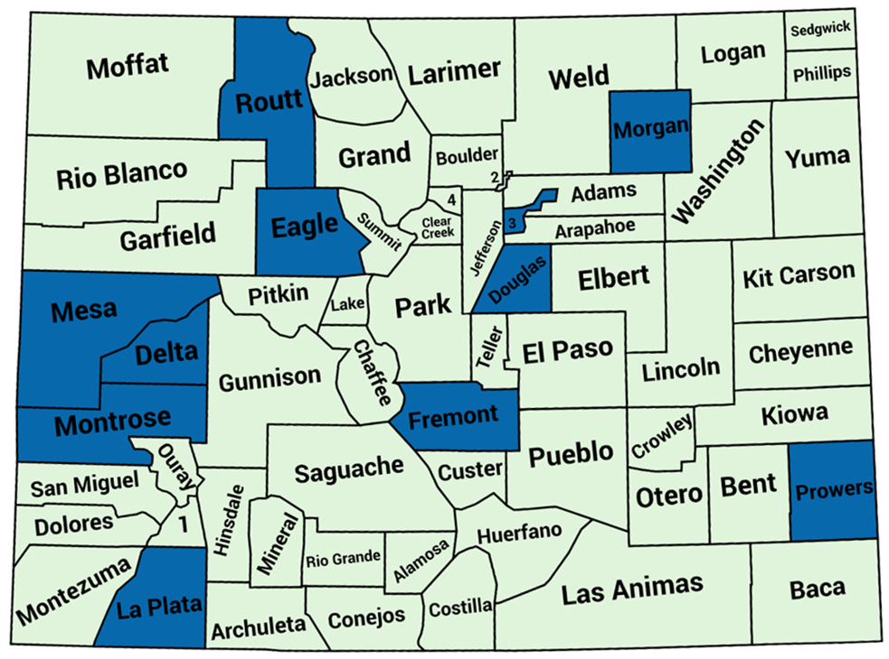
Phase 3: Statewide Implementation
Notes:
Blue counties are 2Gen pilot counties

Slide 36
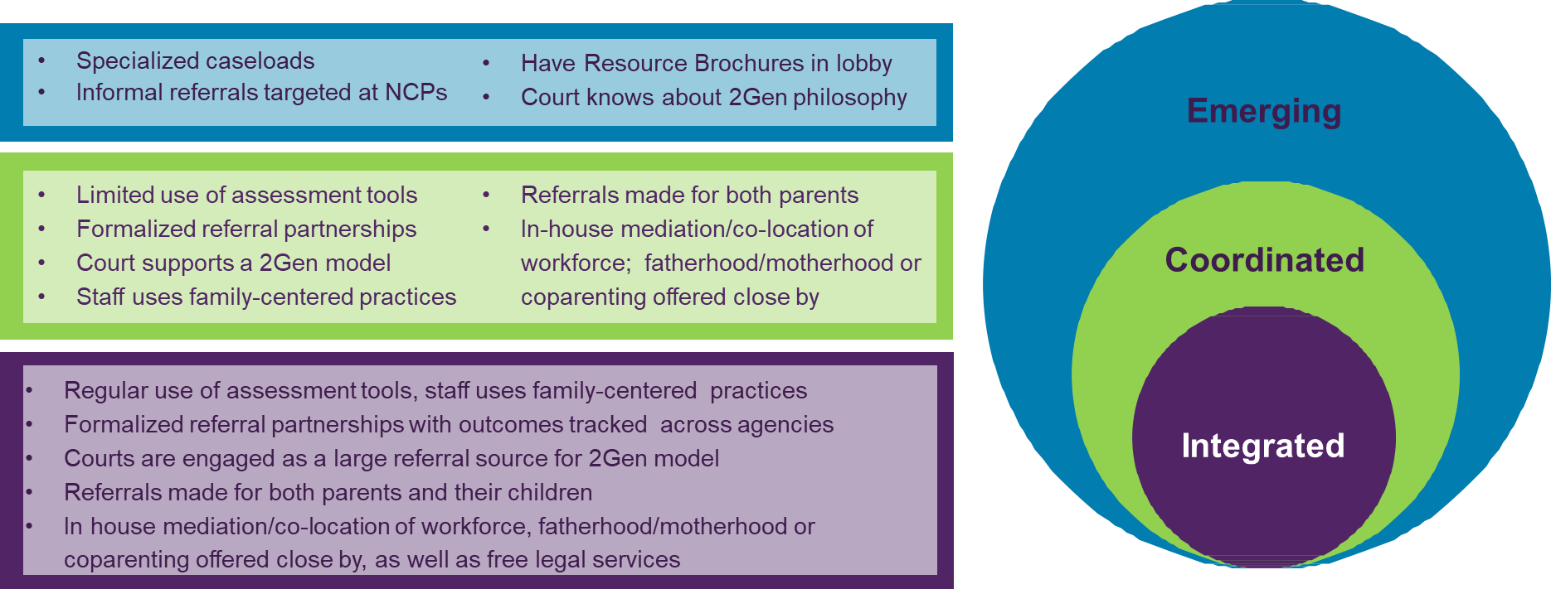
Phase 3: Statewide Implementation
Notes:
Three 2Gen Tiers

Slide 37


Notes:
Partner acknowledgement slide

Slide 38

Seeking the Blue Sky and Setting North Stars
Michigan: Starting the Conversation
Interactive Discussion with States
  Facilitated by:
  Erin Frisch, Chief Deputy Director for Opportunity
  State of Michigan

