Slide 1
Legislative Roundtable
NCCSD Great Lakes, Great Future
Sept. 11, 2019

Slide 2
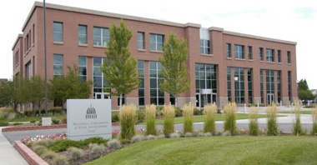
National Conference of State Legislatures
Bipartisan, membership organization
Each of the 50 states and all territories
7,383 state legislators
30,000+ state legislative staff
Research, education, technical assistance
Mission:
Improve the quality & effectiveness of state legislatures
Promote policy innovation and communication among state legislatures
Ensure states have a strong, cohesive voice in the federal system
Notes:
I am sure Nina covered most of this yesterday, but just to reiterate, NCSL is here for you, the Montana legislature.
So much so, that I made sure to make a pitstop to tour the Capitol on my roadtrip last summer!

Slide 3
NCSL’s Work on Child Support Policy
Contract with OCSE to create clearinghouse of policy resources
Track 50-state legislation on child support
Connect legislators and child support directors
Prepare policy briefs, 50-state comparisons, child support 101, quarterly newsletter
Convene meetings, testify before state legislative committees
Highlight state innovations

Slide 4
Child Support and Family Law Database
50-state tracking on:
Child Support Prevention
Custody and Visitation
Economic Stability
Enforcement
Family Law
Family Violence Collaboration
Father Engagement
Guidelines
Health Care Coverage
Healthy Family Relationships
Implementation/Administration
Parentage

Slide 5
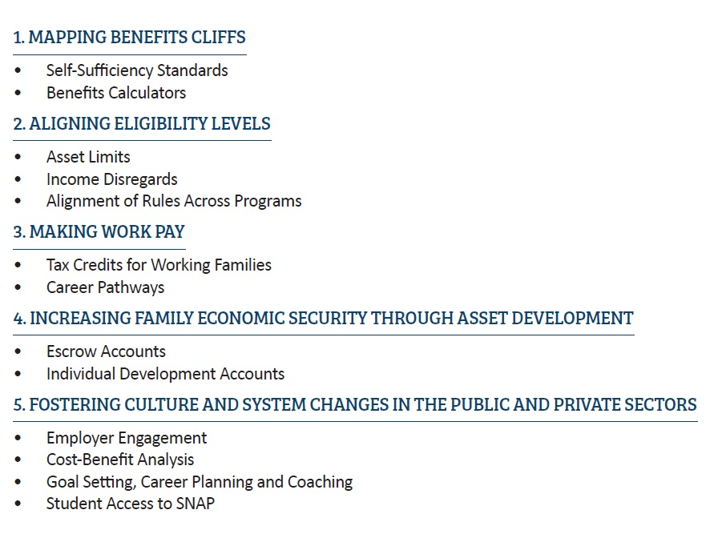
Moving on Up: Helping Families Climb the Economic Ladder by Addressing Benefits Cliffs
Want it sent to your inbox?
Email Meghan.McCann@ncsl.org

Slide 6
New brief: Promoting Parental Employment to Boost Child Support
The Brief Highlights:
The Federal Perspective
State Examples from 8 States Leveraging TANF
Outcomes from the 8 States
Addressing Non-Traditional Workers
How to Fund These Efforts
Access the Brief Here: http://www.ncsl.org/research/human-services/child-support-and-employment-services.aspx
Want it sent to your inbox? Email Meghan.McCann@ncsl.org

Slide 7
Panel
Larry Desbien, IV-D Director, Colorado
Mike Gaskill, State Senator, Indiana
Adam Norman, IV-D Director, Indiana
Dennis DeBar, State Senator, Mississippi
Lyndsy Irwin, IV-D Director, Mississippi
Tawna Sanchez, State Representative, Oregon
Kate Cooper Richardson, IV-D Director, Oregon

Slide 8
Questions?

