Slide 1
National Council of Child Support Directors Conference

Slide 2
Payment Services
Founded in 2008, Value Payment Systems (“VPS”) is a full-service payment services provider utilizing its own proprietary payment platform and gateway to make it easy, secure and efficient for payers to remit payments electronically, resulting in improved financial management and more efficient processing of payments for clients.

Slide 3
Payment Services
Processing ~$4.0bn in payment volume and ~11mm transactions annually
US-based, in-house owned & operated Payment Platform & Gateway
Vertical-specific payment applications with value-add features and functionality
Serving 600+ clients nationwide (+1,200 installations), including:
Federal: Internal Revenue Service (including Intuit, HR Block, Tax Act)
State: 12 States (Income Tax, Child Support, SoS, DoT, etc.)
ChildSupportBillPay: California, Colorado, Hawaii, Indiana, Kansas, Nebraska, New Jersey, Washington, Wyoming
Local: municipalities, utilities, counties, parishes, towns, and cities in over 35 states
ChildSupportBillPay: Several Pennsylvania Counties

Slide 4
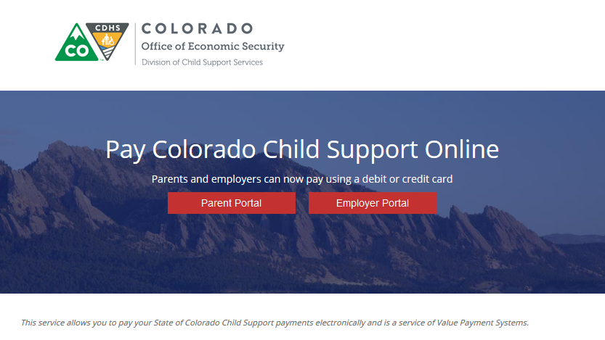
ChildSupportBillPay
Hosted Payment Services
Dramatically Reduced PCI Scope – VPS is PCI DSS Level 1 Certified
Platform Redundancy
Faster Implementation
Business Rules Driven (Payer Validation & Data Collection configured to State’s requirements)
Continually Evolving Payment Solutions
NCP & Employer Payment Portals
NACHA CCD+ Settlement
No-Cost to the State
100% Convenience/Service Fee Funded
Chargeback/Return Liability Indemnification

Slide 5
ChildSupportBillPay
Payment Methods
Dramatically Reduce Payments Barriers
Improves Collections for the Under/Un-Banked
Data Security (Tokenized Wallets, Secure Bank Payments)
AMEX Move (Pay With My Bank)
Payment Channels
Call Center, Online (mobile-optimized), EMV POS, IVR
Payer Adoption Marketing
Provided at no-cost … printed/digital, email, & more.

Slide 6
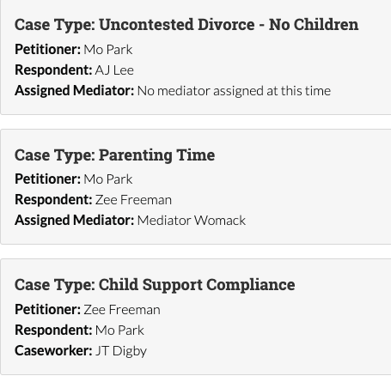
Additional Services
Family & Domestic ODR
IV-D and non IV-D
Parenting Plans/Time
Paternity Establishment
Child Support Compliance
Implementations
Arizona
Michigan
Case Study: 20th Circuit Court, Ottawa County, Michigan

Slide 7
Thank You!
Todd Christensen
Director of Channel Management/Enterprise Solutions
Value Payment Systems
Atlanta, GA
(770) 904-1591

