Slide 1
National Council of Child Support Directors Conference

Slide 2
Using Data to Drive Performance
Performance Measures, Self-Assessment and More
David Kilgore, CA IV-D Director
Adam Norman, IN IV-D Director
Sharon Redmond, WA IV-D Director

Slide 3
Using Data to Drive Performance
Adam Norman, IV-Director
INDIANA

Slide 4
Data Warehouse
Using Data to Drive Performance

Slide 5
Indiana Data Warehouse
Data Warehouse History
Universally Beneficial Reports
County Work Reports
County Performance Maps
Reporting Tools
Reports on Demand
Case Segmentation

Slide 6
Data Warehouse History
Began in 2005 as a means to generate the OCSE-157 Report.
Data repository for ISETS Data
Now have 77 reports available for county users
Reports designed to help users identify cases impacting performance measures
Reports can be easily extracted as needed
Notes:
Data repository for ISETS Data
Data extracted at the end of each week and at month end
-suggest working reports early in the week/month for most current data
Management and Worker reports primarily geared to improve performance measures
Benefits of DWH Reports
– reports for workers designed for workers and by workers
- Able to get reports easily when you want
- can download to excel to easily manipulate reports with sorts and filters
Who has access? – anyone can get, contact the help desk

Slide 7
Universally Beneficial Reports
County Work Reports
Reports designed to assist counties improve performance. Includes the following examples;
Federal Performance Measure Reports (157 Measures)
New IV-D Cases Work Report
Department of Correction Match Report
Cases Where Payments Stop
Stop on Enforcement Report
County Performance Maps

Slide 8
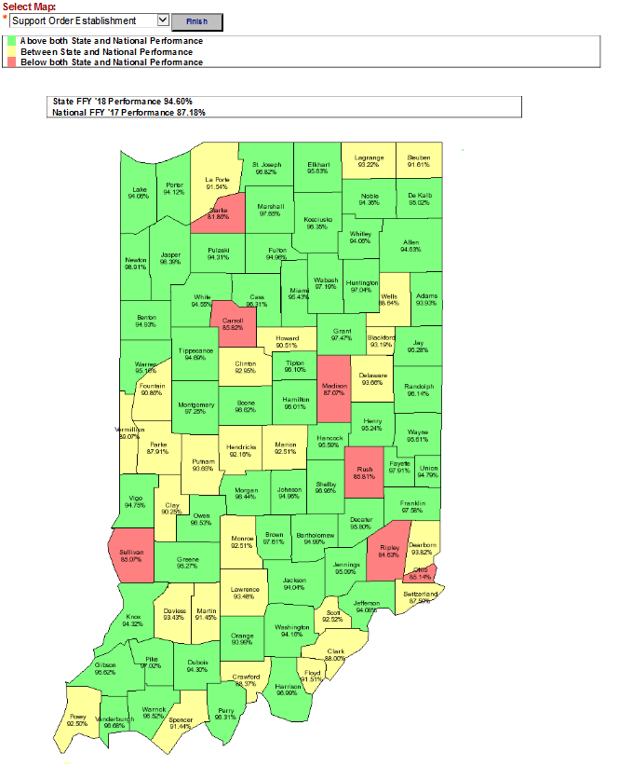
County Performance Maps
The Performance Maps provide a visual display of how individual counties are performing allowing them to see performance compared with other counties.
Notes:
Visual representation of how we are doing in each of the four performance measures Drop box allowing you to select either paternity established, order establishment, current support percentage, or cases paying on arrears
Will give you a red/yellow/green depiction (including percentages) of the state currently, allowing for easy comparison with other counties.
If you click on any given county name, will take you to the associated shortcut report we discussed earlier for that county.

Slide 9
Reporting Tools
Reports on Demand
Allows users to create their own custom reports using a combination of radio buttons and drop boxes to choose desired report criteria
Selections can be saved for future use
Case Segmentation
Categorize the entire open IV-D caseload into groupings (segments) based on key data points and performance within these groupings. Groupings include;
Active current support cases broken out by collection percentage
Arrears Only Cases
Cases Needing Orders Established
Identify problem areas and help determine where to focus attention
Combines elements of work reports and Reports on Demand
Guidance of work reports
Customization of Reports on Demand
Examines the entire caseload, cases won’t fall through the cracks

Slide 10
County Key Metrics
Using Data to Drive Performance

Slide 11
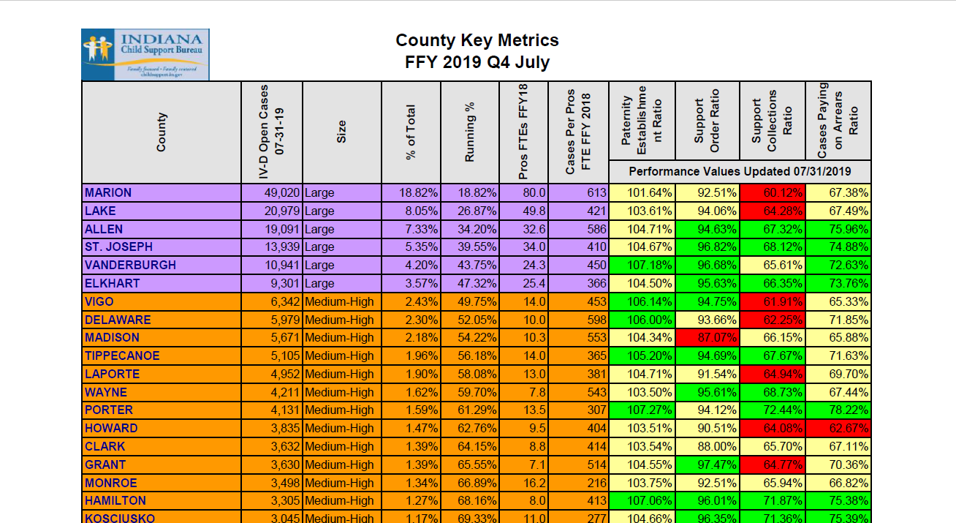
County Key Metrics
Notes:
As many pieces of report data as you’d like to see.
Keep in mind the report will be difficult to print effectively if use too many selections

Slide 12
County Key Metrics
Notes:
As many pieces of report data as you’d like to see.
Keep in mind the report will be difficult to print effectively if use too many selections

Slide 13
IWO
Using Data to Drive Performance

Slide 14
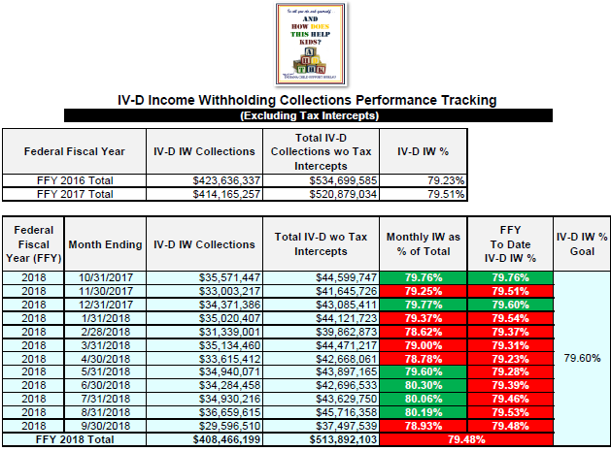
IV-D Income Withholding Collections

Slide 15
IV-D Income Withholding Collections

Slide 16
Undistributed Collections
Using Data to Drive Performance

Slide 17
Undistributed Collections Reports
Work Reports
#1 Transactions Undistributed Due to Case Being Closed - cases are closed
#2 Transactions Undistributed Due to Incorrect Balances - No current balances to apply money to.
#3 Transactions Undistributed Due to Manual Holds - Holds at either participant or case level.
#4 Transactions Undistributed Due to No Subaccount or End-dated Subaccount - Typically no subaccounts have been added to the case yet.
#5 Transactions Undistributed by Category – OCSE-34 Report driven.
Focus primarily on “Unresolved” portion, or the bottom half of the OCSE-34 Report UDC page.
Notes:
4 specific work reports (1-4) and one report that traces back to the UDC as identified by the OCSE-34 Report (#5)

Slide 18
Undistributed Collections Reports
OCSE-34 Report UDC Page
Notes:
The top half of this page is UDC that will typically resolve itself. We generally refer to this as "good" UDC and it is displayed in the color blue on the two subsequent graphics The bottom portion is "BAD" UDC. This is RED in the subsequent two graphics, and it is this that we focus our attention.

Slide 19
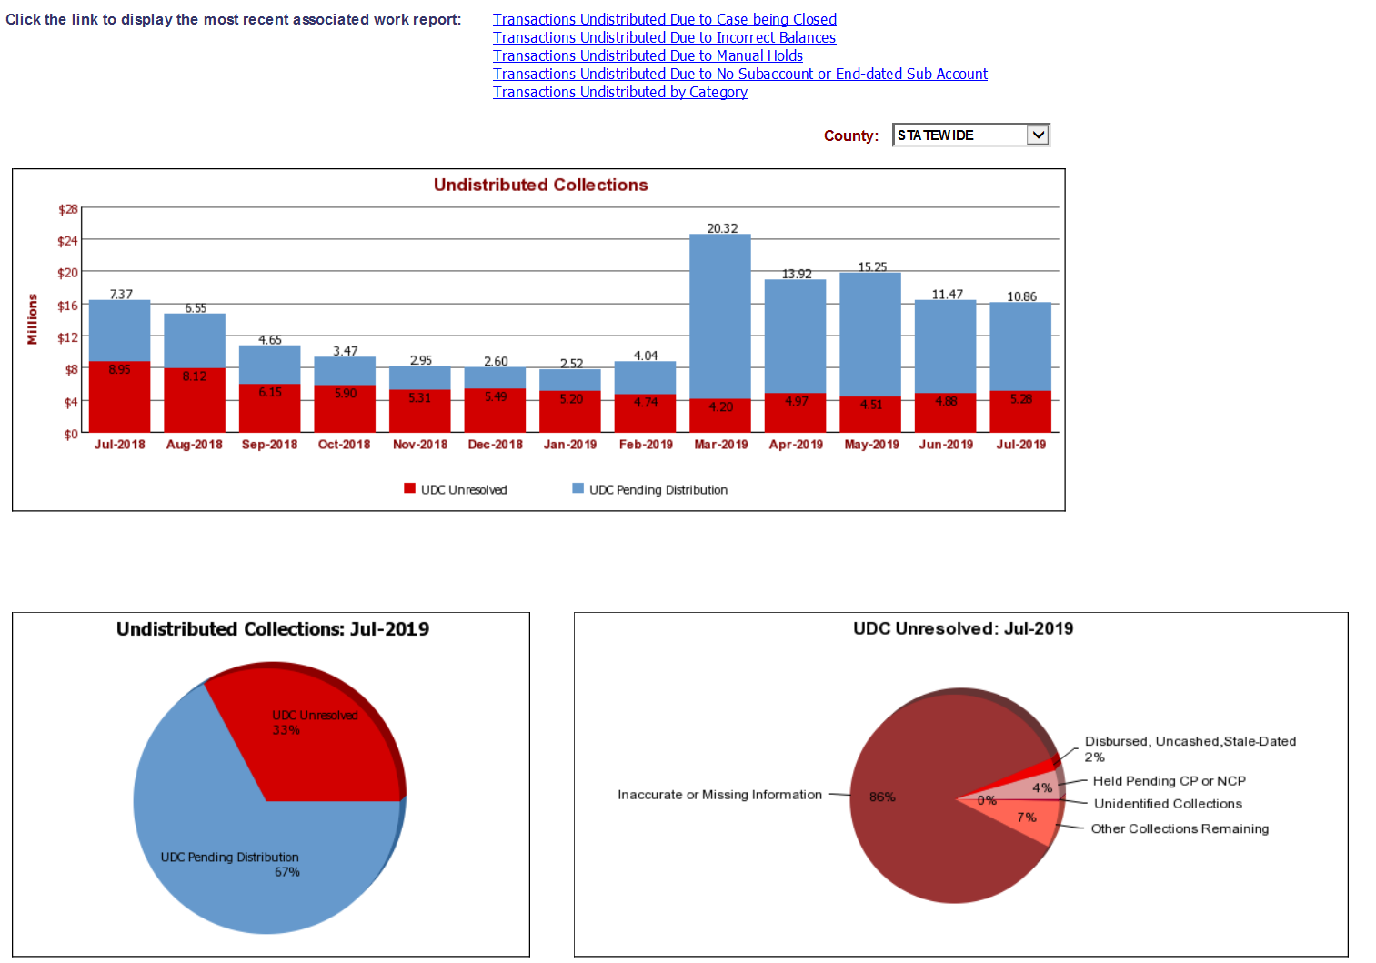
Undistributed Collections Reports
Data Warehouse UDC Dashboard
Notes:
links to work reports on top of screen. pie graphs display "good" vs. "bad" UDC and category breakout of "bad" (RED) specifically

Slide 20
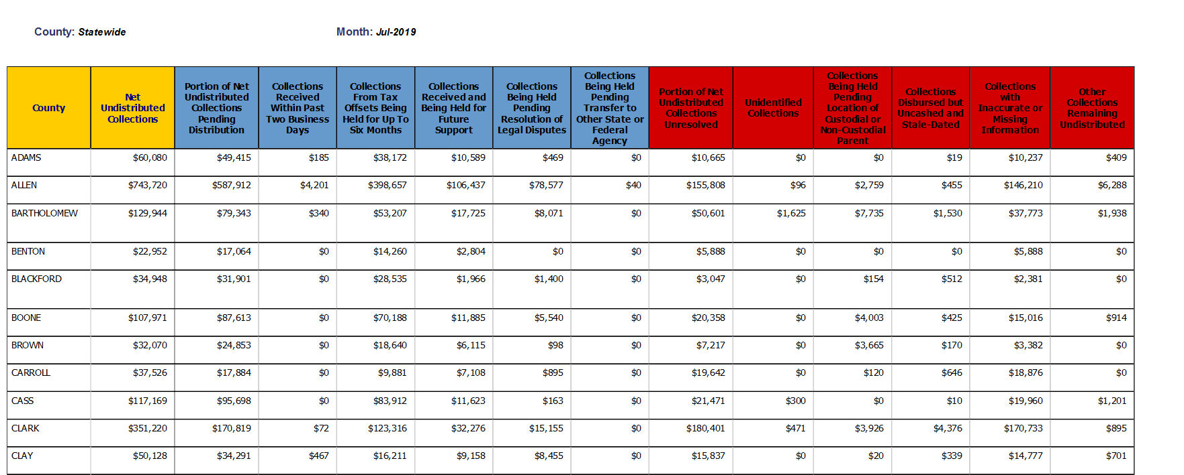
Undistributed Collections Reports
Data Warehouse UDC Dashboard Category Breakout
Notes:
again, focus on the "RED" segments. Users can find individual transactions comprising held dollar amounts. This screen makes it easy for them to see where their money is held, which categories have the most UDC.

Slide 21
Stats at a Glance
Using Data to Drive Performance

Slide 22
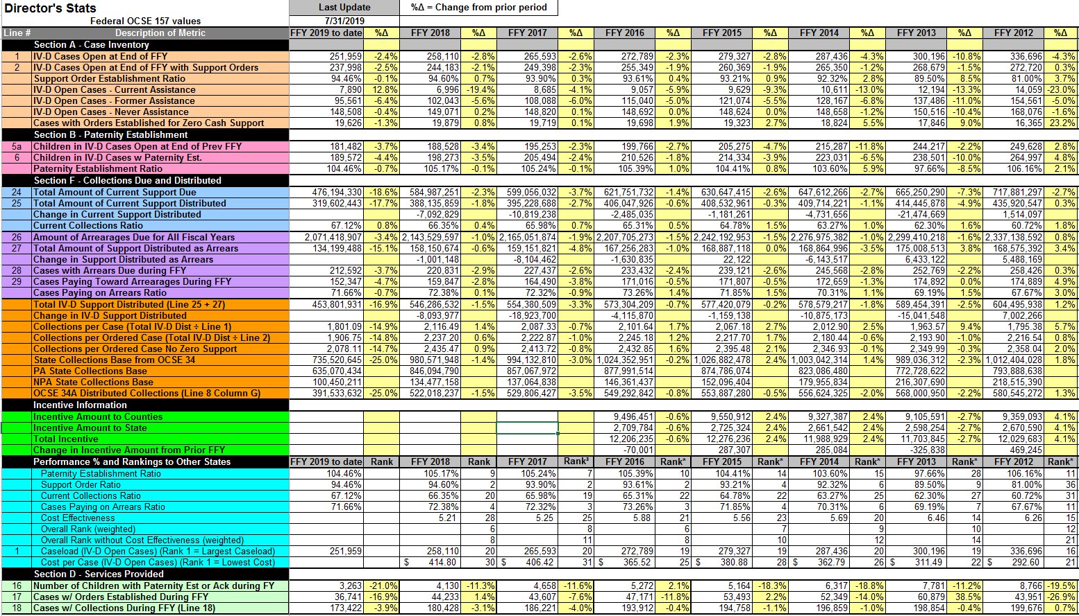
July 2019 Statistics at a Glance

Slide 23
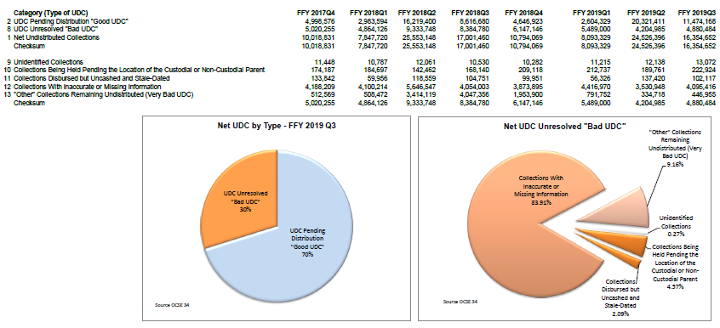
July 2019 Undistributed Collections

Slide 24
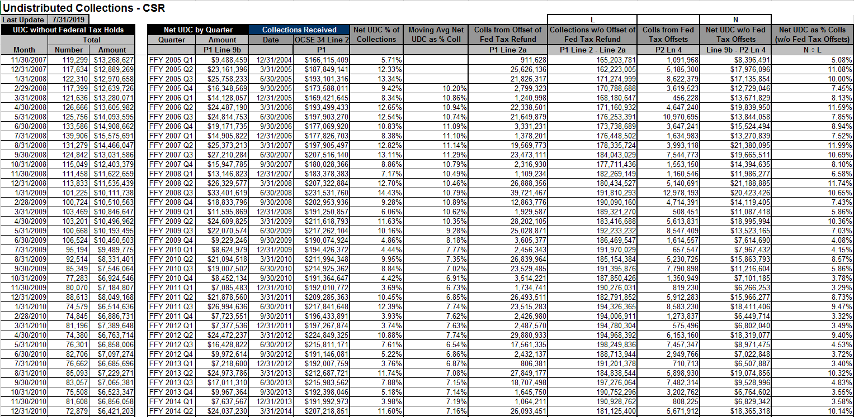
July 2019 Undistributed Collections

Slide 25
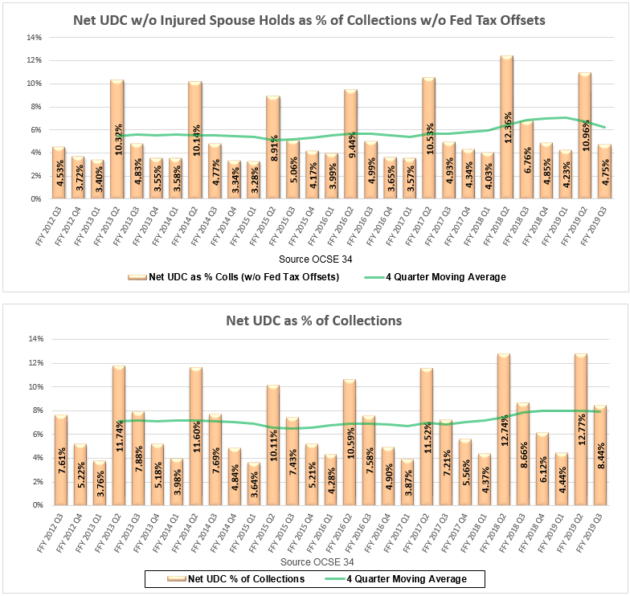
July 2019 Undistributed Collections

Slide 26
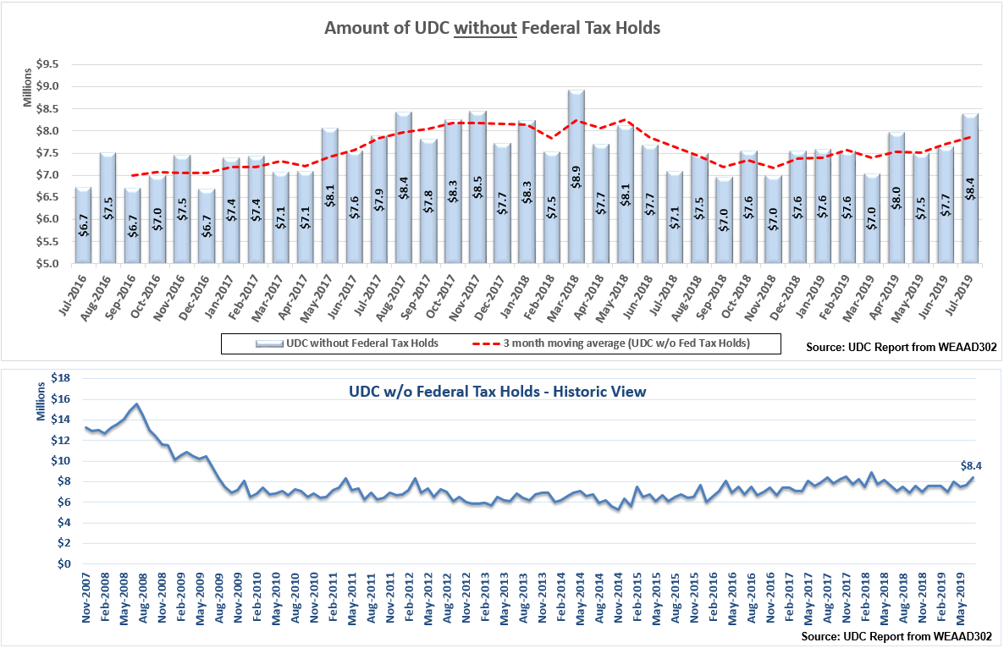
July 2019 Undistributed Collections

Slide 27
Report Data Elements
Adam.Norman@dcs.IN.gov
Notes:
As many pieces of report data as you’d like to see.
Keep in mind the report will be difficult to print effectively if use too many selections

Slide 28
Washington
Division of Child Support
Using Data to Drive Performance
Presented by
Sharon Redmond
Director

Slide 29
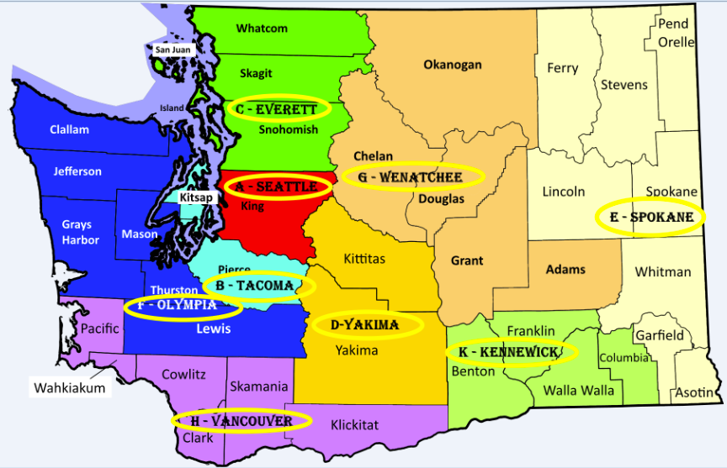
Washington State

Slide 30
Past
Present
Future

Slide 31
WA Performance History
Field Office
Performance Analysts
..an approach to Performance Improvement

Slide 32
Performance Analyst Group
~ Mission ~
To assist in providing continuity in managing and deploying resources that improves performance
~ Vision ~
To create a healthy, vibrant child support program through continuous learning

Slide 33
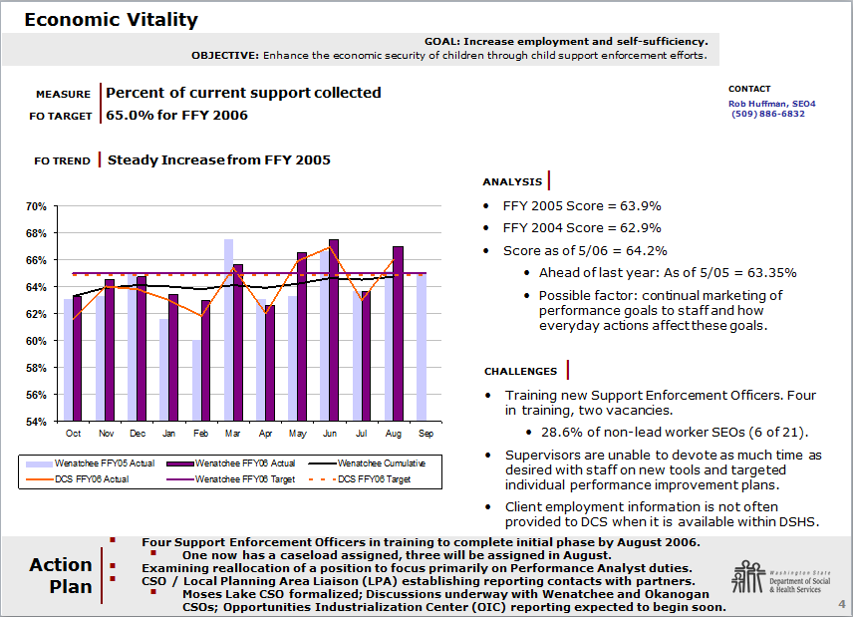

Slide 34
We put our plan into action …and determined we had missed the mark

Slide 35
Past
Present
Future

Slide 36
Performance Collaborative
a group of representatives from each program area in HQ plus the field who brainstorm process improvement projects

Slide 38
Performance Collaborative
~ Mission ~
To design and continuously improve DCS processes to maximize performance to better the lives of children.
~ Vision ~
Individuals, families and communities have the resources they need to live better lives.

Slide 39
Renegotiation Project
During a Thrift Savings Plan (TSP) review we found a lack of consistent practices among offices when renegotiating repayment agreements
Low repayment agreements with an increased ability to pay
Family centered approach
Automated Improvement efforts

Slide 40
No SSN or Date of Birth Project
WA twice the national average in the number of NCPs without a SSN identified
Reviewed list of 1,387 cases statewide
Used an investigative database
Able to identify a SSN and DOB on 417 cases, or 29% of the cases reviewed

Slide 41
Communicating with Numbers & Tips

Slide 42
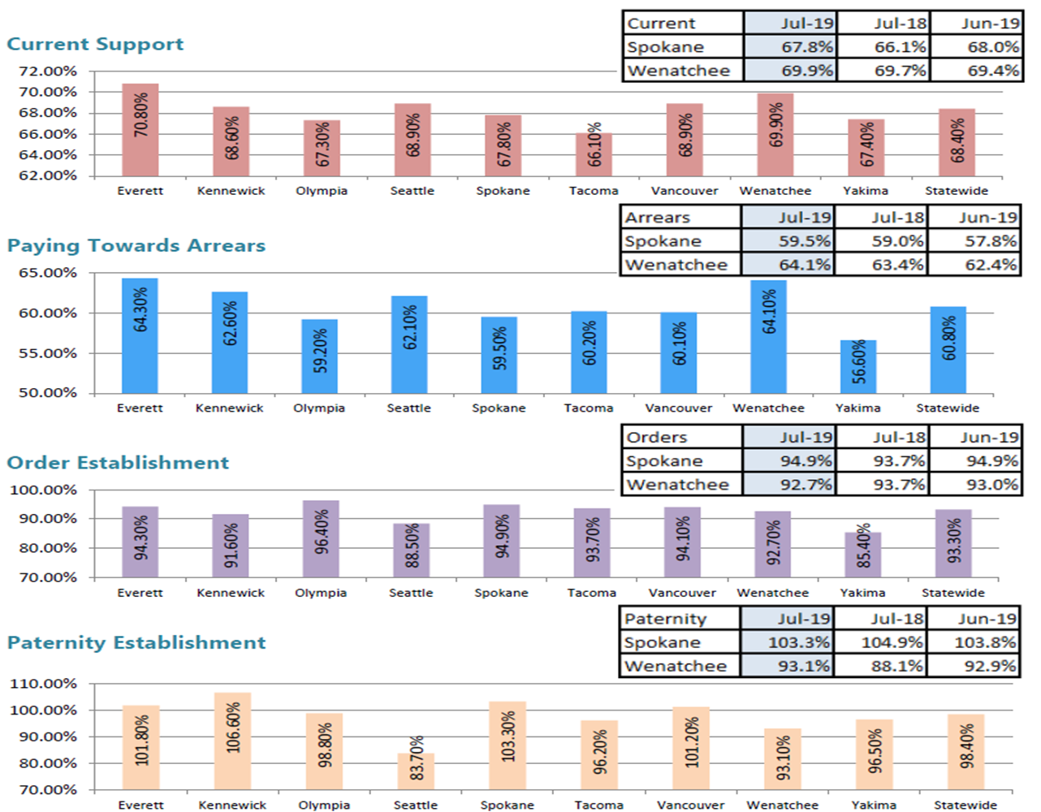

Slide 43
The Bottom Line

Slide 44
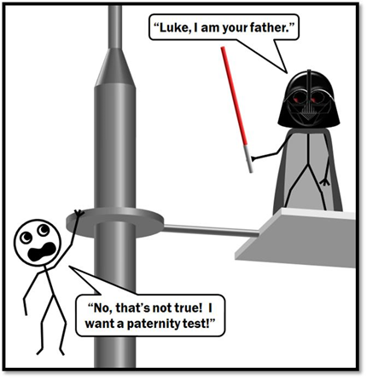
Staff Tips
Paternity Establishment

Slide 45
Past
Present
Future

Slide 46
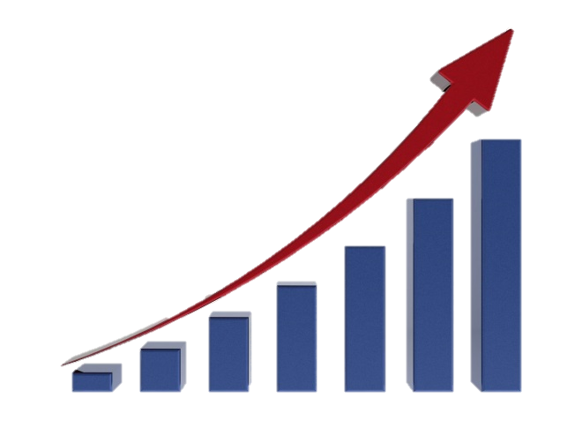
Predictive Analytics
A tool that will help predict the likelihood of future delinquency

Slide 47
Workgroup’s Goal
Develop a statewide tool that predicts the NCPs likelihood of future delinquency and provides strategy suggestions to use with the NCP to encourage NCP to pay.

Slide 48
Data Elements
Percentage of monthly order amount paid in the prior month
Number of continuous payments
Number of enforcement forms generated
Rate of arrears reduction in proportion to the monthly order amount

Slide 49
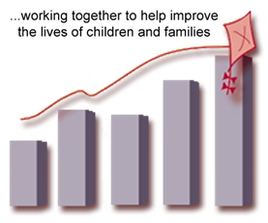
Our Journey Continues

